Slide 1

COM3123 - Lecture 4
Angular Data Binding & Directives

Slide 2
Topics
Data Binding
Interpolation
One Way Binding
Two Way Binding
Pipes
Directives
Custom Directives

Slide 3
Data Binding

Slide 4
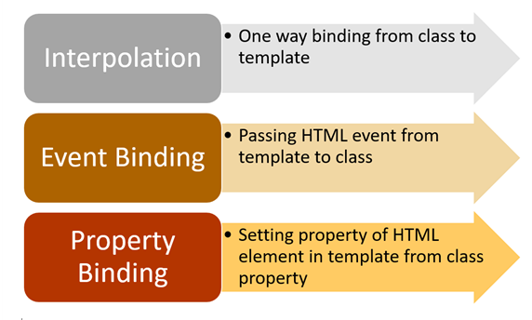
Angular Data Binding
In Angular, data binding determines how data will flow in between the component class and the component template.
Angular provides us with three types of data binding:
Interpolation
One Way Binding
Two Way Binding

Slide 5

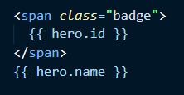
Interpolation
Angular interpolation is one-way data binding. It is used to pass data from the component class to the template.
The syntax of interpolation is {{propertyname}}.
In Angular, there is something called a ChangeDetector Service, which makes sure that value of property in the component class and the template are in sync with each other.

Slide 6
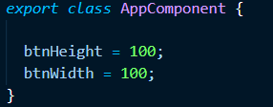
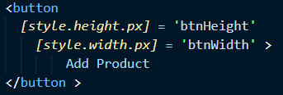
Property Binding
The syntax of property binding is the square bracket [].
Property binding is used to sync the property of HTML elements (image, list, table, etc) with the properties of the component class.
Whenever the property's value in the component class changes, the HTML element property will be updated in the property binding.

Slide 7
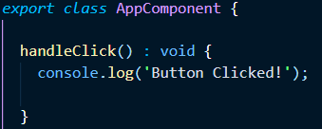

Event Binding
Event binding is used to capture events raised in the template in a component class.
Events such as a click, hover, or a keyboard action are all events that you can use to call the component logic. For more on event types: https://developer.mozilla.org/en-US/docs/Web/Events
This is opposite from property binding, where data is sent from the component class to the view

Slide 8
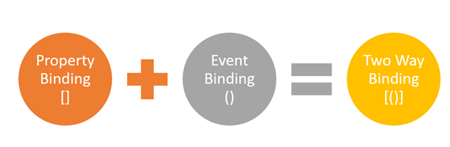


Two Way Data Binding
Two way binding is a powerful way to sync the Template View and Component.
Angular does not a built-in two way data binding, it achieves it by combining property binding with event binding.
The syntax for two way binding is [()]. Sometimes called “banana in a box”

Slide 9
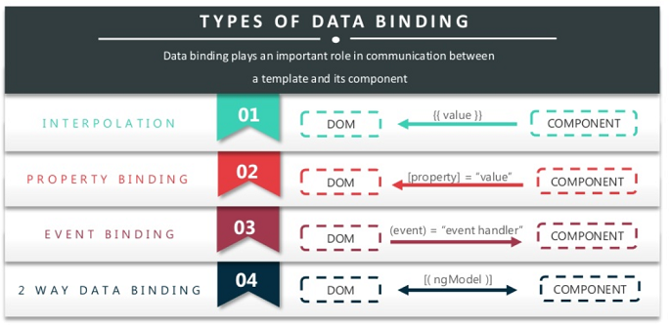

Slide 10
Pipes

Slide 11


Pipes
https://angular.io/api?query=pipe
Transform bound property data before display
Angular comes with a number built-in pipes:
date
number, decimal, percent, currency
uppercase, lowercase
json, slice
etc.
We can build our own Custom Pipes with @Pipe decorator

Slide 12
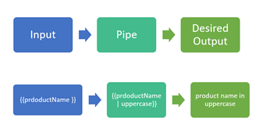
Custom Pipes
@Pipe marks a TypeScript class to be used as an Angular Pipe.
Implement the PipeTransform interface and method to transform the data.
Use Angular CLI command to generate the files
ng generate pipe customUpperCase

Slide 13
Directives

Slide 14
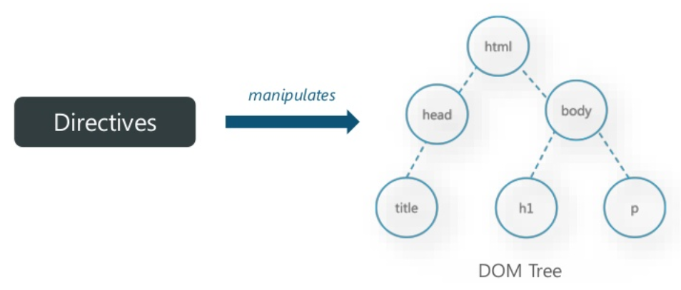
What is a Directive?
Angular templates are dynamic. When Angular renders them, it transforms the DOM according to the instructions given by Directives.

Slide 15
Why do we need Directives?
HTML doesn't support conditional attributes (if, if-else, switch etc.), loop statements (loops) and other attributes.
Angular Directives are used to extend the power of existing Html markup by adding new attributes or tags.
They change the appearance or behaviour of a DOM element.

Slide 16
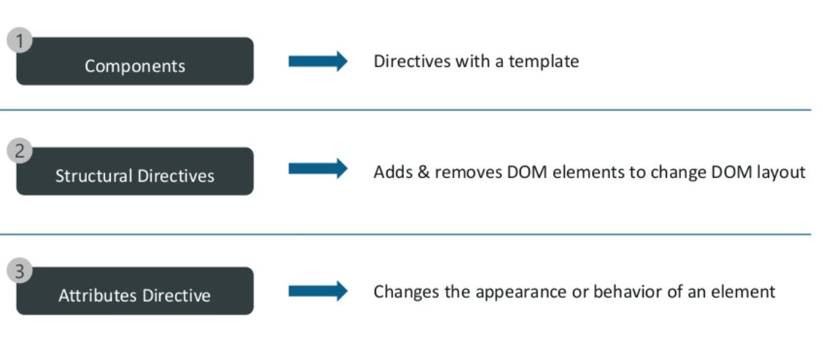
Types of Angular Directives

Slide 17
New Built-in Directives
While Angular 1.x shipped with a bunch of (60+) directives, Angular 2's list of directives is much shorter since the new binding syntax eliminates the need for a lot of them by binding directly to a component's attributes or DOM events.
Angular 1.x you'd have something like ng-click="handleClick($event)" for handling click events on an element.
The Angular 2 equivalent would look like (click)="handleClick($event)", no more need for an ng-click directive.

Slide 18
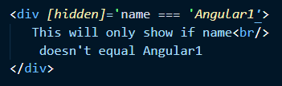
Attribute Directive
https://angular.io/guide/attribute-directives
An Attribute directive changes the appearance or behavior of a DOM element.
Attribute directives are surrounded by brackets which signals to Angular that the appearance or behavior of the DOM elements within the directive may change depending on certain conditions.

Slide 19
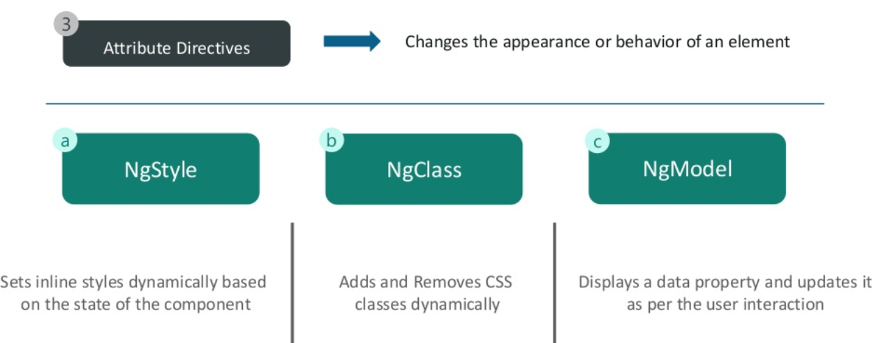
Attribute Directives cont.

Slide 20
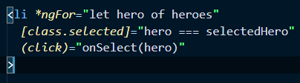
Structure Directives
https://angular.io/guide/structural-directives
Structural directives are responsible for HTML layout. They shape or reshape the DOM's structure, typically by adding, removing, or manipulating elements.
The structural directive needs a host element. The directive then does whatever it's supposed to do with that host element and its descendants..
Structure directives are prefixed with an asterisk *

Slide 21
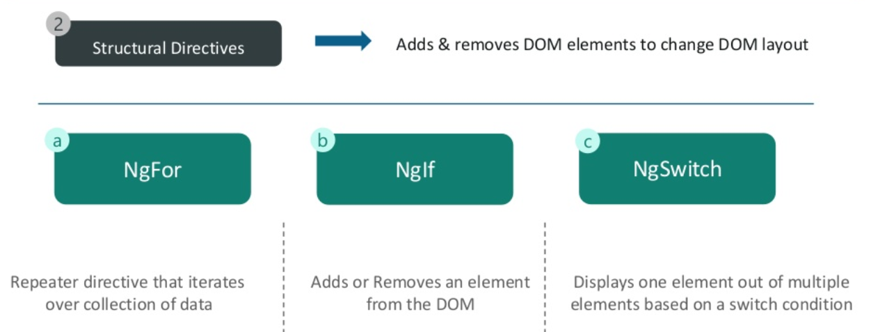
Built-in Structural Directives

Slide 22
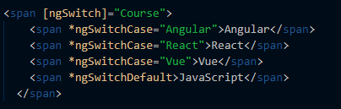
ngSwitch
NgSwitch displays one element from a set of element trees based on conditions
Returns a switch value

Slide 23
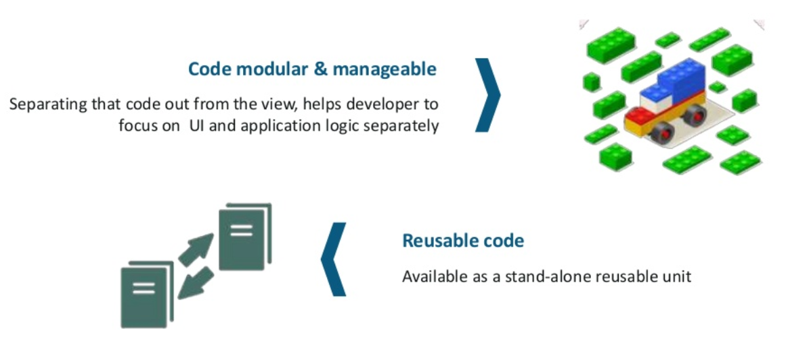
Why do we need Custom Directives?

Slide 24

Custom Directives
@Directive marks a TypeScript class as an Angular Directive.
Set the css selector to trigger the instance of the directive
Use Angular CLI command to generate the files
ng generate directive customInputFormat

Slide 25
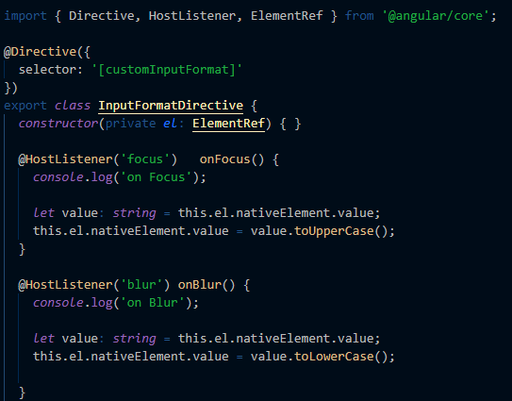
ElementRef - allows the component to access the DOM element
HostListener - subscribes and listens to events of the DOM element
Input - allows data to flow from the binding expression into the directive

